Slide 1

Discovering Manteo Baptist Church

Slide 2
Agenda
1
2
3
4
5
Ministry Vision
Membership Requirements
Core Beliefs
Organization and Structure
Membership

Slide 3
Our Vision

Slide 4
Our Vision
Come
Inviting and welcoming all to experience the joyful rest found only in Jesus Christ (Matthew 11:28)
Connect
Connect with Jesus and other believers in joyful fellowship (1 John 1:3-4)
Grow
Building up believers in the faith (Ephesians 4:11)
Serve
Using one’s gifts and talents in ministry to one another in the church and to people in our community (1 Corinthians 12:4-11; 1 Peter 4:10)
Go
Fulfilling the Great Commission (Matthew 18:18-20) and the Great Commandment (Matthew 22:37-40)

Slide 5
The Great Commission
“And Jesus came and said to them, ‘All authority in heaven and on earth has been given to me. Go therefore and make disciples of all nations, baptizing them in the name of the Father and of the Son and of the Holy Spirit, teaching them to observe all that I have commanded you. And behold, I am with you always, to the end of the age.’” (Matthew 28:18–20, ESV)
The mandate is given to the church by the Lord Jesus.
The mandate is to “make disciples of all nations”
  This involves participating in local missional evangelism
  This also involves participating in world wide evangelism
There are three supporting parts of this work
  Going - Churches send out believers to the mission field and support them on mission
  Baptizing – Churches are to baptize believers, incorporating them into the local church
  Teaching – Churches are to build up believers in the word and prepare them for works of ministry
All believers are to be engaged in fulfilling the Great Commission mandate

Slide 6
Missions Connections
Chowan Baptist Association –
(Rev. James Harrington, Associational Missions Strategist)
Baptist State Convention of North Carolina –
(Dennis Connor & John Gordy, Great Commission Catalyst)
Southern Baptist Convention – Cooperative Program
(North American Mission Board & International Mission Board)
(SBC Disaster Relief)
Various Missionaries and Agencies Supported
Local Mission Initiatives –

Slide 7
Membership Requirements

Slide 8
Membership Requirements
Salvation – A personal profession of faith in Jesus Christ as Lord and Savior (You must be saved.)
Biblical baptism – Baptism by immersion after being saved as a public symbol of one’s position in Christ.
Commitment – Membership is a commitment to the purpose and people of Manteo Baptist Church.
Agreement – Agreement and support of MBC’s statement of faith and practice.

Slide 9

Salvation, The Big Question
Do you know for certain that if you were to die tonight that
you would go to heaven?
If you were to die tonight and God would ask you,
“Why should I let you into my heaven?” What would you say?

Slide 10
Salvation, The Big Plan
Heaven is a free gift. (Romans 6:23)
Man is a sinner and cannot save himself through good works. (Romans 3:23)
God is merciful and does not want to punish us yet since He is just, He must punish sin. (Exodus 34:6-7)
Christ is God and Man who lived a sinless life and died on a cross to pay the penalty of sin to offer us a place in heaven. (John 1:1, 14; 2 Corinthians 5:21)
Faith in Christ alone is the requirement for eternal life. (Ephesians 2:8-9)

Slide 11
Core Beliefs

Slide 12
Core Doctrines, the Ordinances
The Bible Presents Two Ordinances
to be Observed by the Church
Baptism
and
Communion

Slide 13
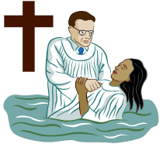
The Ordinance of Baptism
Biblical baptism is . . .
For Believer’s
  Conducted after saving faith. (Acts 8:36-37)
By Immersion
  Greek “baptizo” – dip, plunge or immerse
  The word usage indicates complete infusion
  (John 3:22-23; Acts 8:38-39; Romans 6:3; 1 Corinthians 12:13)
A Step of Obedience (Matthew 28:19)
Symbolic
  Death, burial, and resurrection (Romans 6:3-4)
  Identification with Christ (Luke 3:21)
  Position in Christ (1 Corinthians 12:13)

Slide 14
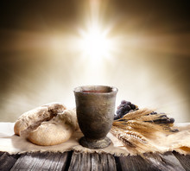
The Ordinance of Communion
For Believers
  Provision for the believer (Luke 22:20)
  Proper aptitude for participation (1 Cor. 11:28-29)
In Remembrance (1 Corinthians 11:23-25)
Obedience (1 Corinthians 11:23-25)
Symbolic
  Death, burial, and resurrection (1 Cor. 11:23-25)
  Identification with Christ (1 Corinthians 10:16)
  Christ is in Me (Galatians 2:20)

Slide 15
Core Doctrines
The Baptist Faith and Message
Manteo Baptist Church holds to the guidelines of the 2000 Baptist Faith and Message.

Slide 16
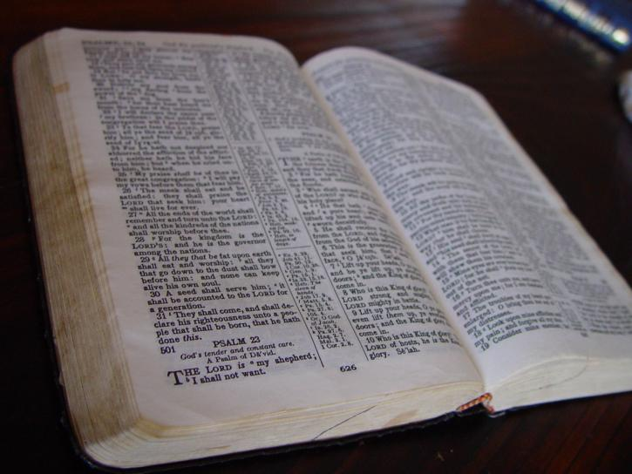
Key Doctrines – The Bible
Is the Word of God (2 Timothy 3:15-17)
Was written by men inspired by the Holy Spirit
Is true as penned by the original authors
Is our source of faith and practice
The central figure is Jesus Christ (Eph 2:20)

Slide 17
Key Doctrines – God
There is one God who eternally exists in three persons, God the Father, God the Son and God the Spirit.
  He is the only true God (Romans 8:9-11)
God is transcendent
God is infinite and perfect in all attributes
  Omnipresent
  Omnipotent
  Omniscient
  Immutable
  Merciful
  Just
  True
  Good
God is sovereign over His creation

Slide 18
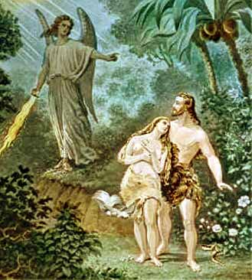
Key Doctrines – Man
God created man in his likeness (Genesis 1:26)
  Mental likeness
  Moral likeness
  Relational likeness
Man disobeyed God and suffered loss (Genesis 3)
The result of sin is death (Genesis 3; Romans 6:23)
  Spiritual death
  Physical death
  Eternal death
This Photo by Unknown Author is licensed under CC BY-NC

Slide 19
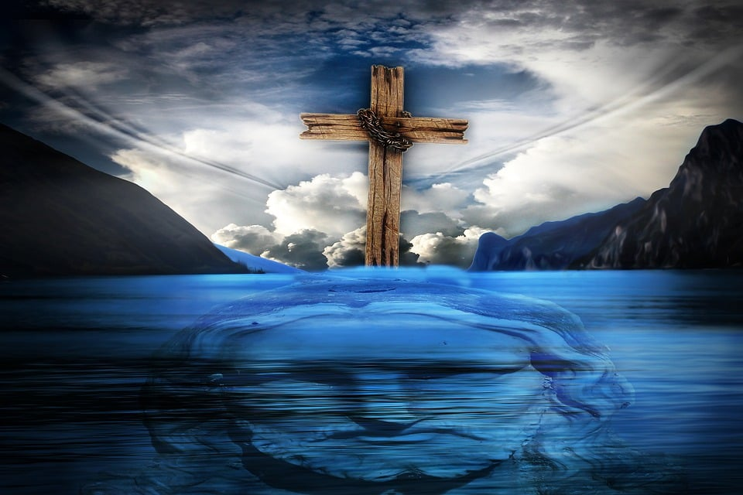
Key Doctrines – Jesus Christ
Jesus is fully God and fully man (John 1:1,14)
He was tempted in every way but never sinned (Hebrews 4:15)
He died on a cross for our sins, was buried, and rose again the third day (1 Corinthians 15:3-4)
He ascended to Heaven and is exalted at the right hand of God (Ephesians 1:20-22)
He is head of the church (Ephesians 1:22)
He is coming again in glory and power (Revelation 22:12)

Slide 20
Key Doctrines – Saving Grace
Salvation is a work of God’s grace alone, apart from any works of man’s self-effort. (Ephesians 2:8-9; Tit. 3:5)
Salvation includes the work of God’s grace in.
  Regeneration
  Justification
  Sanctification
  Glorification
Salvation by grace is the glorious display of God’s sovereign goodness.
Salvation by grace includes God’s keeping of those whom He has saved to the end.
(Romans 11:29; Philippians 1:6; 1 Peter 2:3-5)

Slide 21
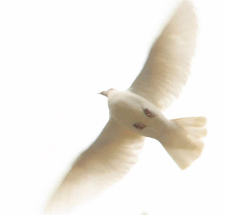
Key Doctrines – Holy Spirit
Five ministries of the Spirit at salvation
  Regeneration – Changes the believer’s nature (Titus 3:5)
    Universal for all believers
    A new divine nature yet the old nature still present
    Change in attitude towards God, His ways and sin
    Desire for God and the things of God
  Baptism – Positions the person in Christ (1 Cor. 12:13)
    Universal for all believers
    A new position in Christ
    A member of the body of Christ, the church
    Immersed in Christ’s righteousness, death, burial, resurrection and glorification
This Photo by Unknown Author is licensed under CC BY-NC-ND

Slide 22
Key Doctrines – Holy Spirit
Five ministries of the Spirit at salvation
  Sealing – Secures the believer in Christ (Eph. 1:13; 4:30)
    Universal for all believers
    Security of the believer - If saved then always saved
  Indwelling – Dwells within the believer (Romans 8:9)
    Universal for all believers
    Believer’s body a temple of God
    Enabling the believer to live the Christian life
  Imparting spiritual gifts (1 Corinthians 12:4, 7)
    Universal for all believers
    Variety of spiritual gifts
    For use in the church
    To benefit all
This Photo by Unknown Author is licensed under CC BY-NC-ND

Slide 23
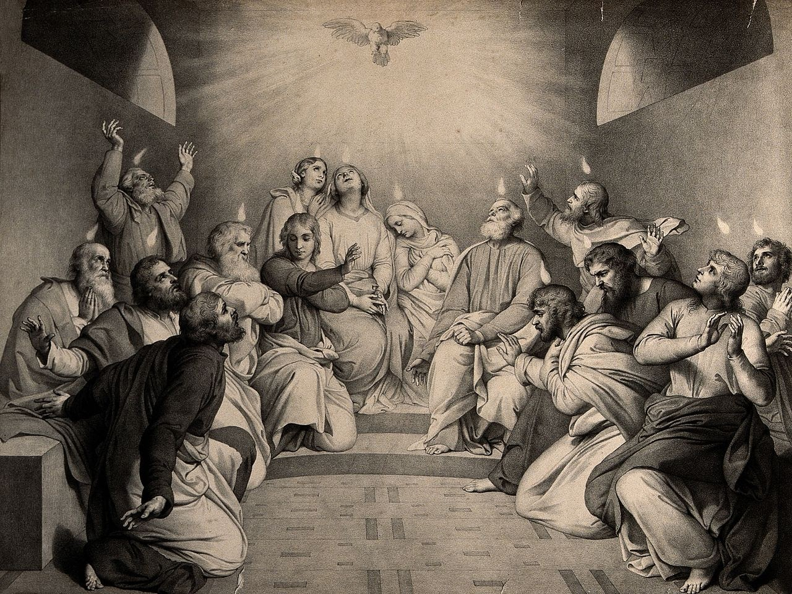
Key Doctrines – Holy Spirit
Ministry of the Spirit after salvation
  Spirit filling the believer (Ephesians 5:18)
  A command for the believer
    God desires it as a continual condition
    Dependent upon the believer’s submission
    Dependent on the believer’s spiritual walk
    Essential for growth in Christ likeness
    Essential for victorious Christian living
    Essential for every aspect of the believer’s life
This Photo by Unknown Author is licensed under CC BY-SA-NC

Slide 24
Key Doctrines – The Church
(Matthew 16:18)
The universal church consists of all true believers
The local church consists of those who
  Profess Christ as their Savior
  Submit to believer’s baptism
Jesus is the head of the church and its builder
Jesus appoints people to ministries in the church
This Photo by Unknown Author is licensed under CC BY-SA-NC

Slide 25
Key Doctrines – Future Events
Jesus will return personally, visibly and gloriously (Acts 1:11)
There will be a resurrection of all
  The saved (1 Thessalonians 4:16-17)
  The unsaved (Revelation 20:13-14)
There will be a future judgment of all men
  The saved to reward and heaven (John 14:1-3; 2 Corinthians 5:10)
  The unsaved to everlasting punishment (Matthew 25:41, 46; Revelation 20:15)
This Photo by Unknown Author is licensed under CC BY-SA-NC

Slide 26
Organization and Structure

Slide 27
Organization and Structure
Southern Baptist Churches are fully autonomous congregations that affiliate with the Southern Baptist Convention and participate with the Cooperative Program.
Supporting Mission
Southern Baptist Convention
North Carolina Baptist Convention
Chowan Baptist Association
Manteo Baptist Church

Slide 28
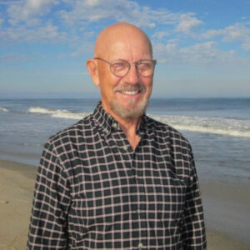
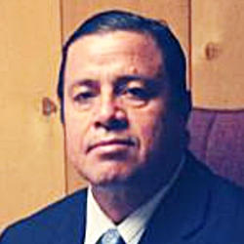
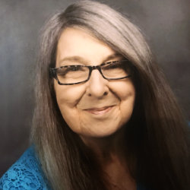
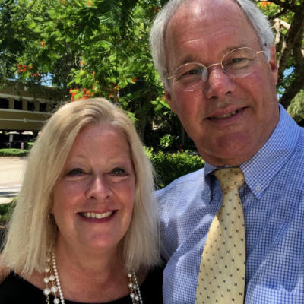
Meet our Staff
Dr. Steve Hankins
Rev. Boanerges Calvio
Lois Givans
Priscilla Weir
Interim Pastor
Hispanic Mission Pastor
Administrative Assistant
Music Director
Allen Hurdle
Emily Pack
Mike Hollowell
Chairman of Deacon Fellowship
Youth Director
Custodian

Slide 29
Organization and Structure
Administrative Assistant
Children’s Ministry
Tech Team
Senior Pastor
Board of Deacons
Christian Education
Finance
Administration
Missions & Evangelism
Young Adults & College

Slide 30
Organization and Structure
Administration
& Finance
Treasurer &
Assistant
Counters
Historian
Facilities
Administration
Church Clerk & Assistant
Church Management Information Systems
Finance
Church Sign
Stewardship & Finance
Bulletin Boards
Tech Team
Audio / Visual
Church Management Information Systems
Website
Facebook
Facebook
Van Ministry
Constitution &
By-Laws
Flowers & Beautification
Buildings & Grounds
Custodial
Welcome Center
Messengers
State Convention
Chowan Association
Nominating Committee
Pastor Search Committee

Slide 31
Organization and Structure
Christian Education
& Discipleship
Preschool 3&4 year old combiners
K – 1 & 2
Sunday Young Adult / College & Careers
Wed. Evening Children’s Ministries
Sunday Adult Program
Adult 1
Sunday Children’s Program
Ladies 2
Ladies 3
Grades 3 – 5
Middle 6 – 8
Sunday Youth Highschool 9 - 12
New Covenant
G.A.s
R.A.s
Mission Friends
Sunday Evening Children
Word of Life – Olympians
Ages 7-8
Word of Life – Gopher Buddies Ages 4 - 6
Media & Library

Slide 32
Organization and Structure
Missions and Evangelism
V.B.S.
RA’s
GA’s
Mission Friends
Men’s Mission
& Evangelism
Baptist Men
F.I.S.H
Training & Evangelism
Dare Days
Local & International Missions
Disaster Relief
Children’s Mission & Evangelism
Women’s Mission & Evangelism
W.M.U.
Women’s Jail Ministry
Outreach Events
Men’s Prison Ministry
Basketball Camp
Manteo Baptist Youth League
Missions
Serve
North Carolina
Campground

Slide 33
Organization and Structure
Caring & Fellowship Ministries
Hospitality & Social
Family Ministry
Bereavement
Homecoming
Coffee Shop
Senior Adults Fellowship

Slide 34
Organization and Structure
Weekly Worship and Prayer Services
Nursery
Music Team
Audio / Visual
Greeters
Sunday AM
Coffee Shop
Sunday PM Worship
Music
Sunday Evening Youth
Sunday Evening Children
Wednesday Evening Prayer
Children’s Ministries
Youth Ministry
1st Wednesday Fellowship Meals
Lord’s Supper
Sunday AM Worship
Baptism

Slide 35
Membership

Slide 36
Five Reasons for Joining a Church
Assurance and Accountability – The desire to walk in the Christian faith attests to the assurance of your conversion. Church membership provides a community of people to help continue in this desire. (Hebrews 10:24)
Missions and Evangelism – God’s plan is for a collective effort of God’s people to extend the blessings of His grace to the world. (Matthew 28:18-20)
Affirming Sound Theology – When believers join together, they demonstrate unity in affirming certain inalienable truths. (Titus 1:9)
Edification of the Church – The church is the people and God plans for the building up of the church by having each member use their spiritual gift to benefit the whole. (Eph 4:11-12)
The Glory of God – The church is the body of Christ and God joins each member together to display the glory of His grace. (1 Peter 2:12)
  (Selected items from “A Display of God’s Glory” – Mark Dever)

Slide 37
Expectations of Membership
Protect the unity of my church
  By acting in love toward other members / attendees visitors
  By supporting the leadership
  By refusing to gossip about or be slanderous towards anyone in our church
  By refusing to be divisive in any way
Share in the responsibility of my church
  By faithfully praying for our church
  By continuously inviting others to attend
  By warmly welcoming all who visit
  By caring for the facilities of our church

Slide 38
Expectations of Membership
Serve in the ministry of my church
  By discovering and using my gifts and talents in an area of passion
  By being equipped to serve
  By developing a servant’s heart
  By regularly involving myself in the ministry of the church
Support the testimony of my church
  By living a Christ-like life
  By faithfully attending corporate worship services & other gatherings
  By upholding the church’s statement of faith and practice
  By regularly giving financially to our church

Slide 39
Means of Joining in Membeship
Transfer membership from another Southern Baptist Church
Statement of faith and baptism
  The candidate will indicate that they have trusted in Jesus Christ alone for his or her salvation.
  The candidate will indicate that they have been baptized by immersion after coming to faith in Jesus.
By baptism by immersion
  The candidate must have made a true profession of saving faith.
  Upon baptism by immersion, the candidate may become a member.

Slide 40
Removal From Membership
Extended absence from fellowship or contact with MBC
  (Applies to those who disappear with no contact for one year.)
Uniting with another church (Membership should be transferred)
  (Believers should be united with one church fellowship)
Voluntary request
  (Request must be submitted to the pastor and deacon Board)
Unrepentant habitual disobedience to God’s word
  (This to be handled in accordance with Matthew 18:15-17)
  (Reuniting with fellowship is possible based upon demonstrated repentance.)

